Slide 1



Is your commute ruining your day?
Say goodbye to wasted time, frustrating delays, and transportation headaches with our seamless commuting experience..

Slide 2
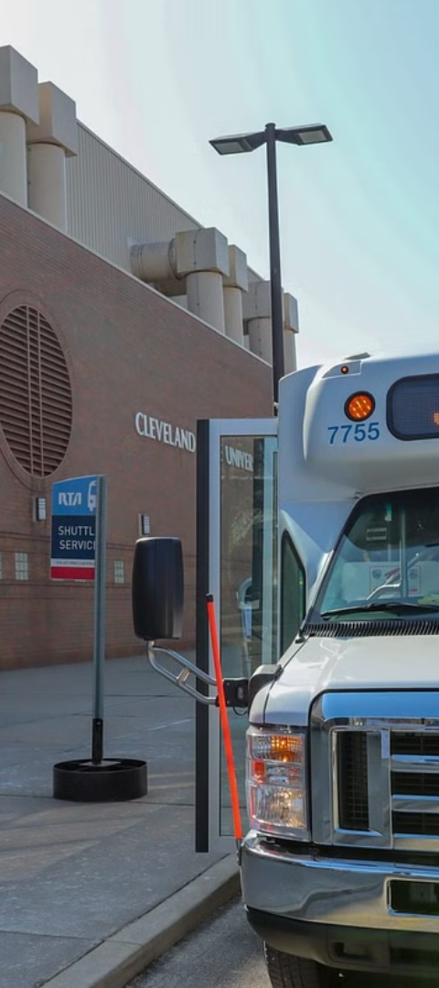
Market Analysis: Commuter Challenges
Long Wait Times
Bus Schedule Uncertainty
Commuters face extended waiting periods at transit stops, leading to frustration and inefficiency.
Unclear or inconsistent bus schedules create stress and make planning difficult for commuters.
Public Transportation Navigation Challenges
Difficulty in navigating public transit systems adds to commuter frustration and travel delays.

Slide 3

Our App's Features and Benefits
Real-Time Bus Tracking: Users can track the location of buses in real-time on a map, reducing wait times and uncertainty.
Accurate Schedules: Access to up-to-date bus schedules ensures users can plan their journeys with confidence.
Navigation Assistance: Step-by-step navigation guides users to their destinations, helping them navigate the public transportation system effortlessly.
Customized Alerts: Get instant notifications on bus arrival times and any delays.

Slide 4
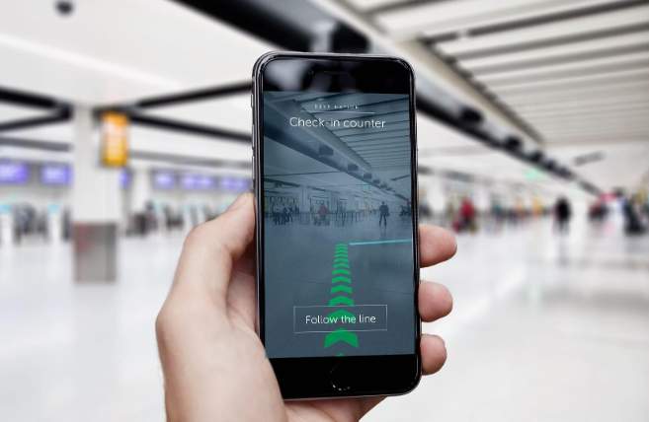
User Experience: How Our App Simplifies Commuting
Our app provides real-time updates on bus arrival times, eliminating uncertainty.
Users can easily navigate public transportation routes and receive notifications for any changes.
The app offers a seamless experience, reducing the stress of commuting.

Slide 5
Competitive Advantage
User-Centric Design
Customized Route Recommendations
Enhanced Safety Features
Our app prioritizes user experience, with intuitive navigation and personalized features.
Utilizing advanced algorithms, our app provides tailored route suggestions based on user preferences.
Unique safety features include real-time tracking, emergency support, and crowd-sourced security alerts.
Seamless integration of real-time updates enhances the user journey.
Interactive maps ensure efficient and stress-free navigation.

Slide 6

Revenue Model: Monetizing the App
1
Freemium Model
Offer basic features for free and charge for premium add-ons and advanced functionalities.
2
Advertising Partnerships
Collaborate with local businesses to display targeted ads based on user location and preferences.
3
Subscription Plans
Provide monthly or annual subscription options for exclusive access to enhanced features and benefits.

Slide 7



Marketing strategy: Target audience, channels, and tactics
Target Audience
Social Media Channels
Local Partnerships
We focus on urban commuters, particularly professionals and students who value convenience and efficiency in their daily commutes..
Utilize Instagram and Twitter for targeted ads and engaging content. Social media campaigns, influencer partnerships.
Collaborations with transportation agencies, universities and city transit authorities for outreach.

Slide 8

Partnerships: Potential Collaborations
Our app aims to establish strategic partnerships with public transportation agencies and relevant organizations in order to enhance the user experience and provide comprehensive solutions. By collaborating with these entities, we seek to improve transit services and offer seamless integration with existing infrastructure.
These partnerships will enable us to access real-time data, optimize route planning, and provide users with accurate and up-to-date information. We are committed to fostering mutually beneficial relationships that prioritize the needs of commuters and the community.
In addition, these collaborations will allow us to explore innovative initiatives such as integrated ticketing systems, shared mobility services, and sustainability efforts. Together, we can revolutionize the commuting experience for everyone.

Slide 9



Roadmap:
1
Expand to new cities and regions
2
Enhance User Interface/ User Experience with additional features
3
Launch App with core features (bus tracking, schedules, navigation)

Slide 10

Supercharge Your Commute with Our Amazing App
Ready to revolutionize your daily travel experience? Download our app now and say goodbye to endless wait times, frustrating uncertainty, and mind-boggling navigation challenges.
Join the thousands of savvy commuters who have already transformed their journeys with our cutting-edge solution.
For more information on our app or any other inquiries, please contact us:
Email: nginamungai8@gmail.com
Phone: ​+254 768817124​

